Slide 1

Travel Mate
Online Tour & Travel Booking System
Projected by: Muhammad Awais
Project Supervisor: Mohammad Moeen Ud Din

Slide 2
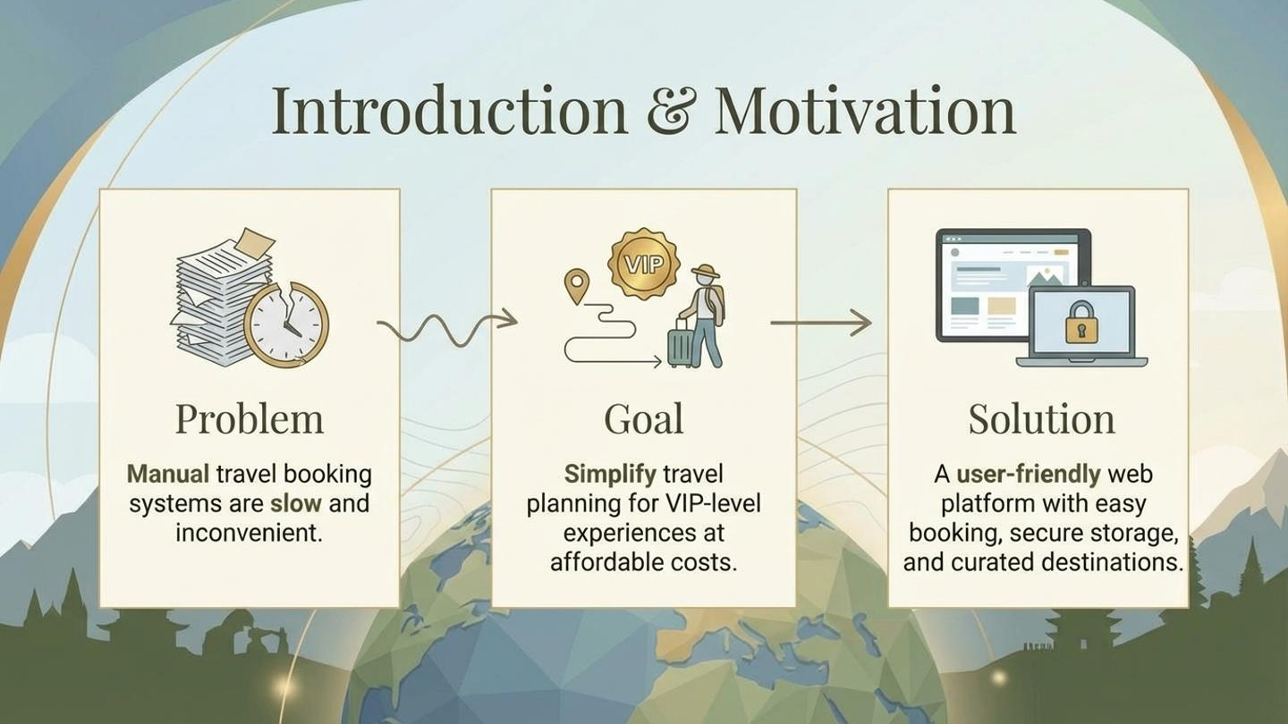

Slide 3
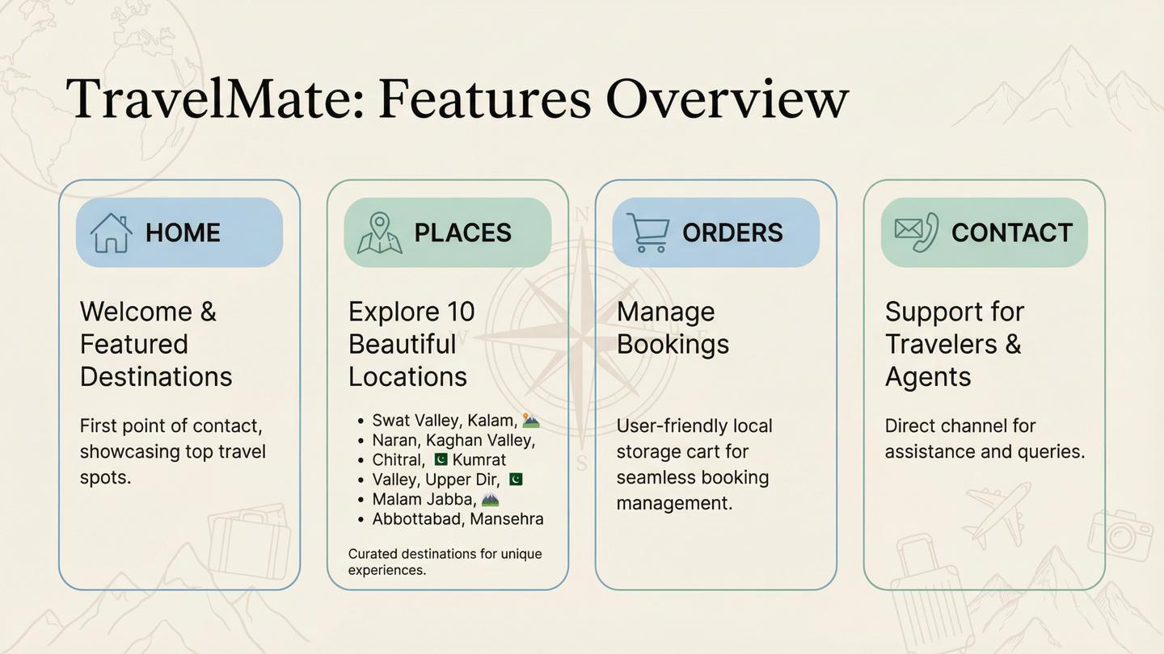

Slide 4
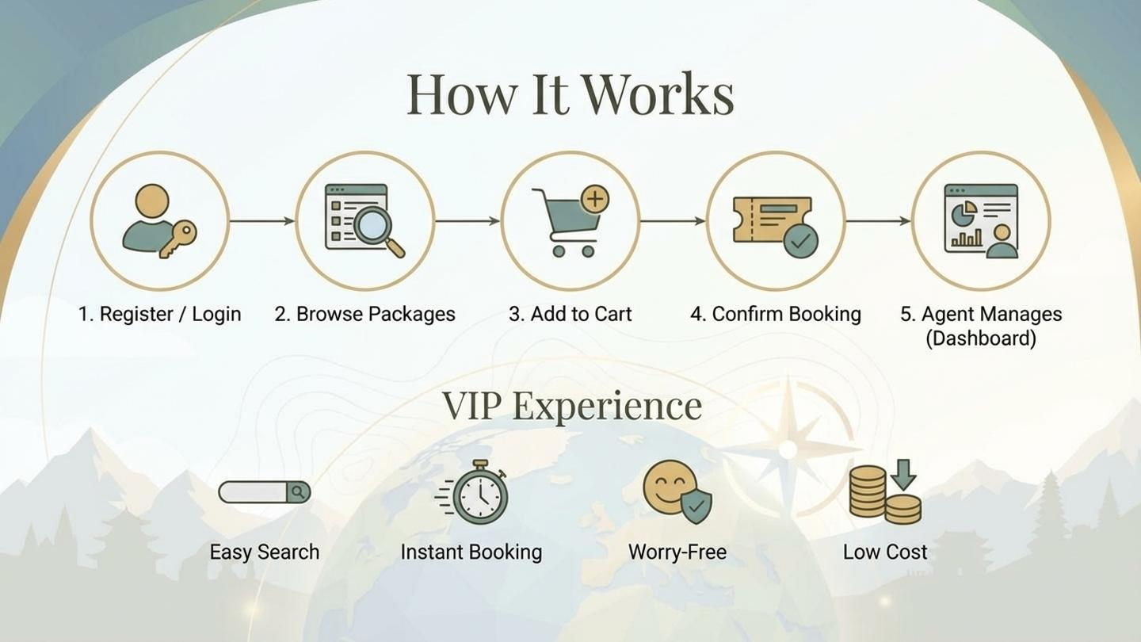

Slide 5

Thank You
Questions?

